Slide 1
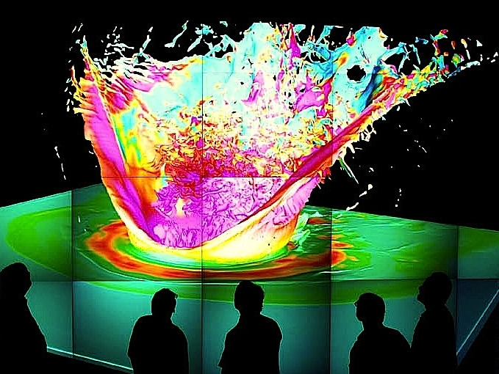
PHYS 8750 Numerical Fluid Dynamics
“K-T impact” simulation of 65 million years ago
Science: Gisler, Greene, Weaver, Gittings – Los Alamos Nat’l Lab
AMR “SAGE” code
Fall, 2020

Slide 2
PHYS 8750
Outline
PDE with two variables
Shallow-water equations
Von Neumann Method
Discrete-dispersion method
Staggered grid for multi-variables PDEs linked to physics.
Staggered grid for shallow-water equations.
Examples (Codes)
Class #10 (Chapter 3.3)
Space Filtering in TIEGCM
Class #11 (Chapter 4.1)
1) PDE with two variables
2) Shallow-water equations
3) Staggered grids

Slide 3
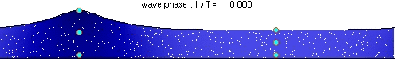
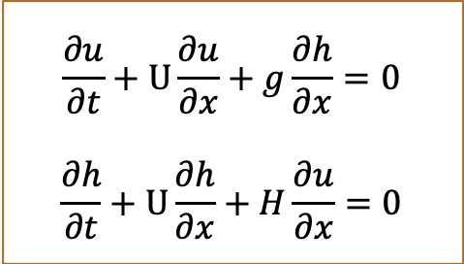
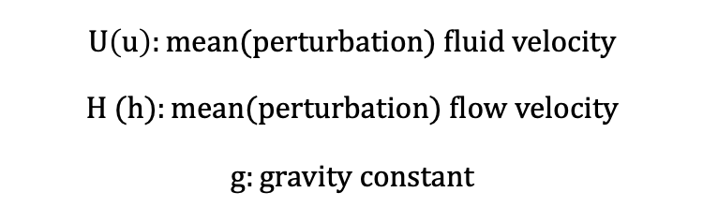
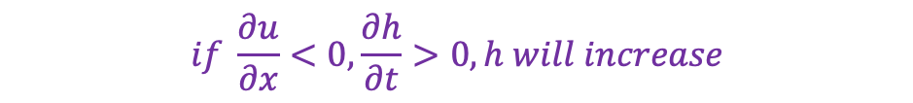
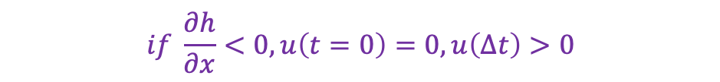
Shallow-Water Equations
Shallow-Water Equations:
Physics:
Higher depth would be pulled down by gravity, which leads to horizontal motions.
Building up of horizontal motions will lead to changes to water depths.
Addition to this: advection of water depth and velocity by the mean flow.
$$\frac{∂u}{∂t}+U\frac{∂u}{∂x}+g\frac{∂h}{∂x}=0$$
$$\frac{∂h}{∂t}+U\frac{∂h}{∂x}+H\frac{∂u}{∂x}=0$$
$$U\left(u\right):mean(perturbation) fluid velocity$$
$$H (h):mean(perturbation) flow velocity$$
$$g:gravity constant$$
$$if \frac{∂h}{∂x}<0, u\left(t=0\right)=0,u\left(∆t\right)>0$$
$$if \frac{∂u}{∂x}<0,\frac{∂h}{∂t}>0, h will increase$$

Slide 4
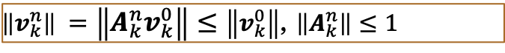
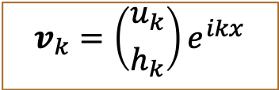
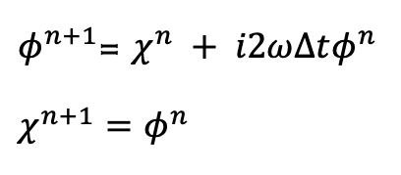
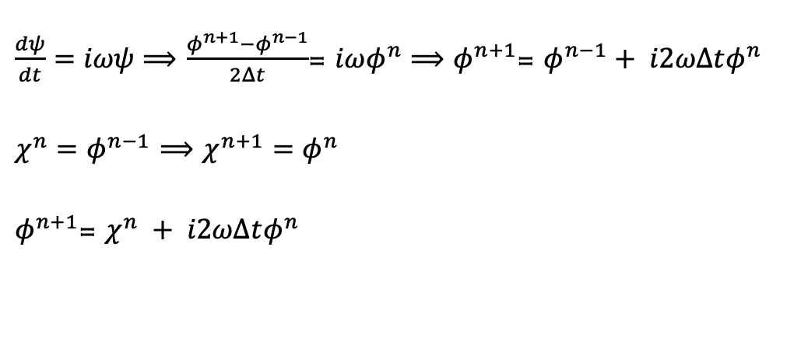
Von Neumann Stability
For k-th wavenumber
$$v_{k}=\left({u_{k} \atop h_{k}}\right)e^{ikx}$$
If true solution doesn’t grow with time:
$\left\|v_{k}^{n}\right\| =\left\|{A_{k}^{n}v}_{k}^{0}\right\|≤\left\|v_{k}^{0}\right\|$, $\left\|A_{k}^{n}\right\|≤1$
If true solution grows with time:
$$\left\|v_{k}^{n}\right\| =\left\|{A_{k}^{n}v}_{k}^{0}\right\|≤C_{T}\left\|v_{k}^{0}\right\|,\left\|A_{k}^{n}\right\|≤C_{T}, for all n∆t≤T$$
Apply to Leap-Frog Scheme and wave equation:
$\frac{dψ}{dt}=iωψ⟹$ $\frac{φ^{n+1}−φ^{n−1}}{2Δt}$= $iωφ^{n}⟹φ^{n+1}$= $φ^{n−1}+ i2ωΔtφ^{n}$
$χ^{n}=φ^{n−1}$ $⟹$ $χ^{n+1}=φ^{n}$
$φ^{n+1}$= $χ^{n} + i2ωΔtφ^{n}$
$φ^{n+1}$= $χ^{n} + i2ωΔtφ^{n}$
$$χ^{n+1}=φ^{n}$$

Slide 5
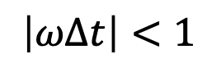
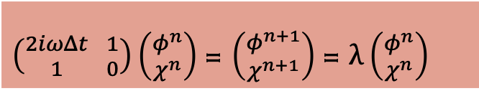

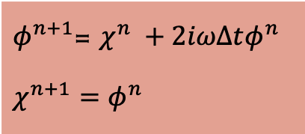
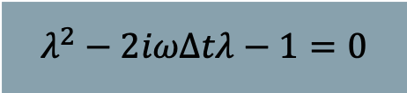
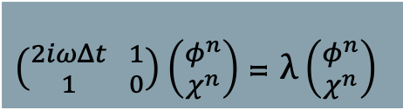
Von Neumann Stability
Multi-Variable PDEs
$φ^{n+1}$= $χ^{n} +2iωΔtφ^{n}$
$$χ^{n+1}=φ^{n}$$
$\left({2iωΔt \atop 1} {1 \atop 0}\right)\left({φ^{n} \atop χ^{n}}\right)$= $\left({φ^{n+1} \atop χ^{n+1}}\right)$= $λ\left({φ^{n} \atop χ^{n}}\right)$
Eigenvalue $λ$for the amplification matrix satisfy:
$\left({2iωΔt \atop 1} {1 \atop 0}\right)\left({φ^{n} \atop χ^{n}}\right)$= $λ\left({φ^{n} \atop χ^{n}}\right)$
$$λ^{2}−2iωΔtλ−1=0$$
Similar to what we did before, solve for roots from the quadratic equation, and make sure $\left|λ_{±}\right|≤1$
$$\left|ωΔt\right|<1$$
Key: find out the amplification coefficient matrix, the eigenvalue would be the amplification factor. Then solve for the quadratic equations and get constraints from bounded amplification factor

Slide 6
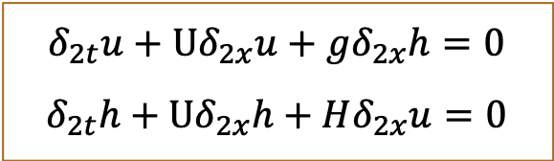
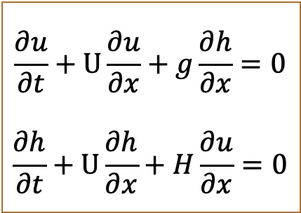
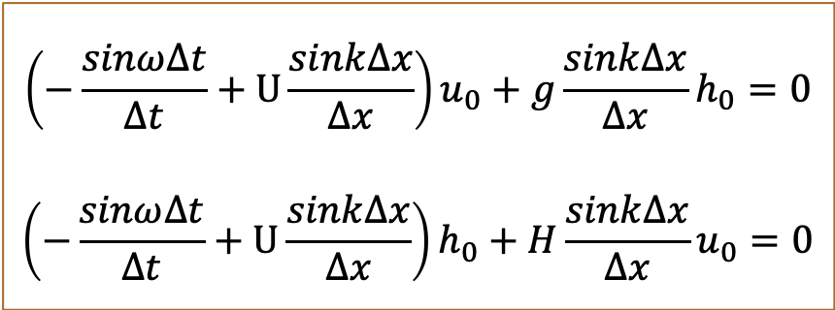
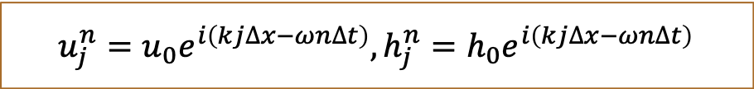
Discrete-Dispersion Relation
$$\frac{∂u}{∂t}+U\frac{∂u}{∂x}+g\frac{∂h}{∂x}=0$$
$$\frac{∂h}{∂t}+U\frac{∂h}{∂x}+H\frac{∂u}{∂x}=0$$
leapfrog
$$δ_{2t}u+Uδ_{2x}u+gδ_{2x}h=0$$
$$δ_{2t}h+Uδ_{2x}h+Hδ_{2x}u=0$$
Center space
$$u_{j}^{n}=u_{0}e^{i\left(kj∆x−ωn∆t\right)},h_{j}^{n}=h_{0}e^{i\left(kj∆x−ωn∆t\right)}$$
$$\left(−\frac{sinω∆t}{∆t}+U\frac{sink∆x}{∆x}\right)u_{0}+g\frac{sink∆x}{∆x}h_{0}=0$$
$$\left(−\frac{sinω∆t}{∆t}+U\frac{sink∆x}{∆x}\right)h_{0}+H\frac{sink∆x}{∆x}u_{0}=0$$

Slide 7
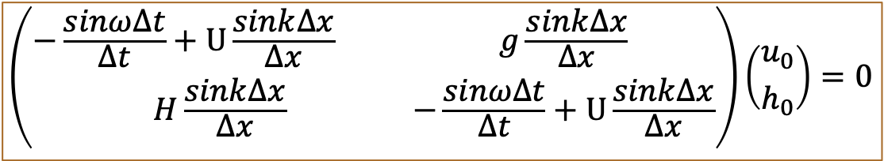
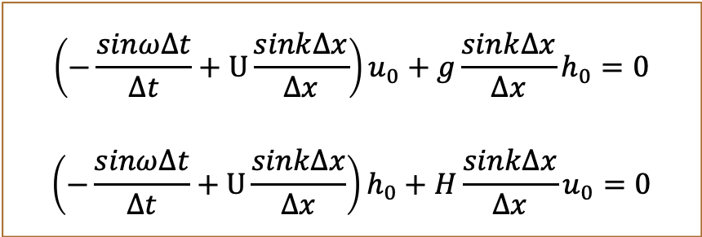
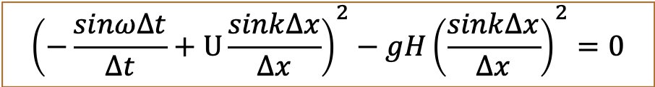
Discrete-Dispersion Relation
$$\left(−\frac{sinω∆t}{∆t}+U\frac{sink∆x}{∆x}\right)u_{0}+g\frac{sink∆x}{∆x}h_{0}=0$$
$$\left(−\frac{sinω∆t}{∆t}+U\frac{sink∆x}{∆x}\right)h_{0}+H\frac{sink∆x}{∆x}u_{0}=0$$
$$\left({−\frac{sinω∆t}{∆t}+U\frac{sink∆x}{∆x} \atop H\frac{sink∆x}{∆x}}{g\frac{sink∆x}{∆x} \atop −\frac{sinω∆t}{∆t}+U\frac{sink∆x}{∆x}}\right)\left({u_{0} \atop h_{0}}\right)=0$$
$${\left(−\frac{sinω∆t}{∆t}+U\frac{sink∆x}{∆x}\right)}^{2}−gH{\left(\frac{sink∆x}{∆x}\right)}^{2}=0$$

Slide 8
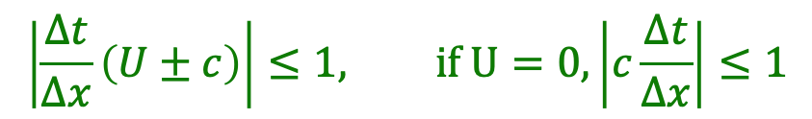
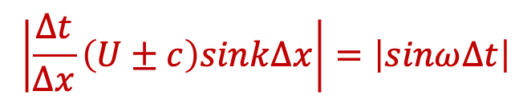
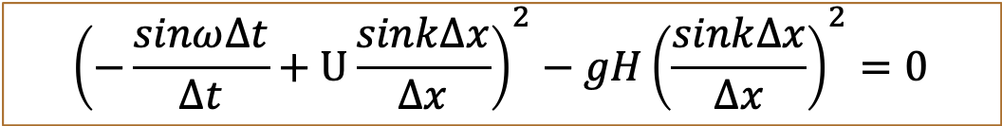
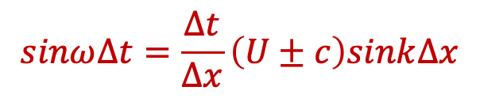
Discrete-Dispersion Relation
$${\left(−\frac{sinω∆t}{∆t}+U\frac{sink∆x}{∆x}\right)}^{2}−gH{\left(\frac{sink∆x}{∆x}\right)}^{2}=0$$
Define $c=\sqrt{gH},$ discrete-dispersion relation:
$$sinω∆t=\frac{∆t}{∆x}\left(U±c\right)sink∆x$$
If $ω=ω_{r}+iω_{i},$ then $ω_{r}$determines wave phase, $ω_{i}$gives growth rates
To avoid amplitude growth, $ω$ cannot have imaginary part:
$$\left|\frac{∆t}{∆x}\left(U±c\right)sink∆x\right|=\left|sinω∆t\right|$$
To satisfy this relation anytime:
$$\left|\frac{∆t}{∆x}\left(U±c\right)\right|≤1, if U=0,\left|c\frac{∆t}{∆x}\right|≤1$$

Slide 9
Left side of “=“ … time rate of change of each variable.
Right side: Pressure gradient force
Variables:
u: X-wind component
v: Y-wind component
w: Z-wind component
θ: potential temperature
p: pressure

Slide 10
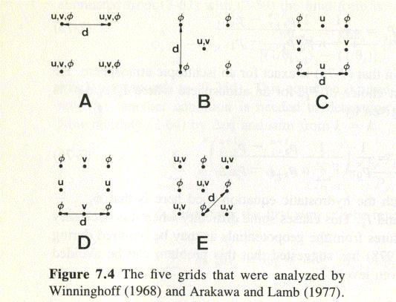
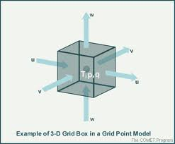
Staggered grids
Haltiner and Williams
A-grid: No staggering
C-grid: velocities on normal faces of mass points.
Different u,v locations; truncation errors - Coriolis terms
Better at higher resolution (than B-grid)
C-grid staggering.

Slide 11
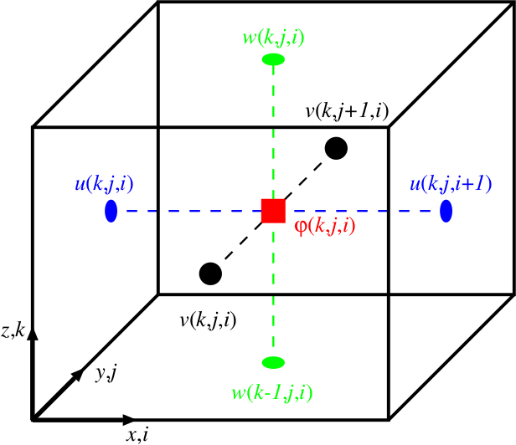
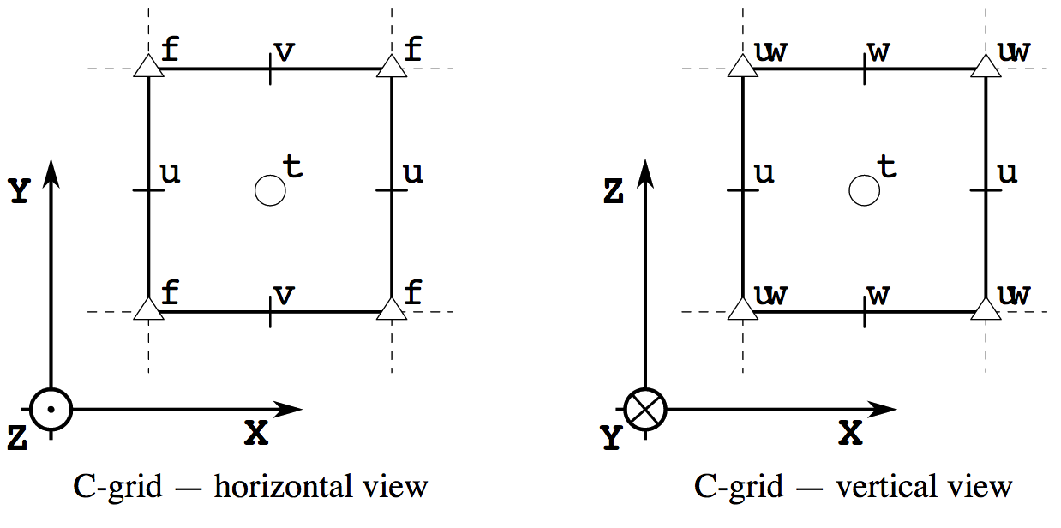
Staggered grids: C-grid for all variables
When coding a solver for multiple variables, you must consider the grid indexing centered on each variable.
w(i,j,k+1)
u
T
u
Horizontal
view
v(i,j+1,k)
u(i,j,k)
u(i+1,j,k)
Adapted from: https://palm.muk.uni-hannover.de/trac/wiki/doc/tec/discret
T(i,j,k)
w
Adapted from: http://pycomodo.forge.imag.fr/norm.html#dimensions
v(i,j,k)
Vertical
(x-z) view
u
T
u
w(i,j,k)
w
"scalar quantities are defined at the center of each grid volume, whereas velocity components are shifted by half a grid width in their respective direction so that they are defined at the edges of the grid volumes"

Slide 12
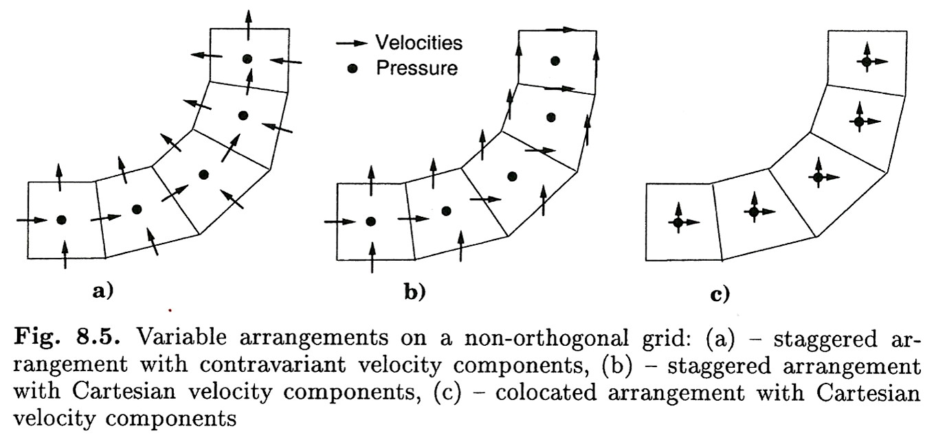
Numerical methods: Staggered grids
Key advantage: improved phase behavior
Example: A non- orthogonal grid
Ferziger and Peric (2002), Chapter 8, Complex Geometries

Slide 13
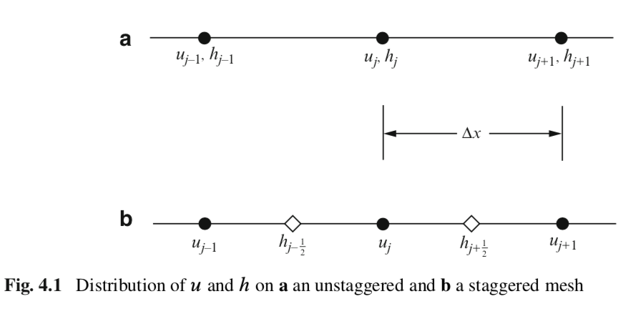
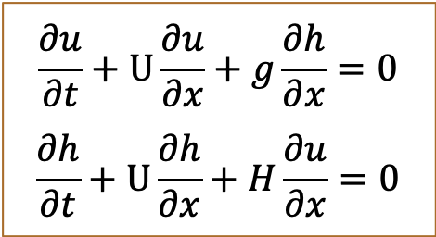
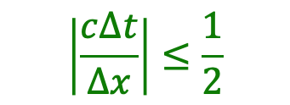
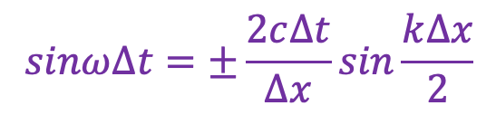
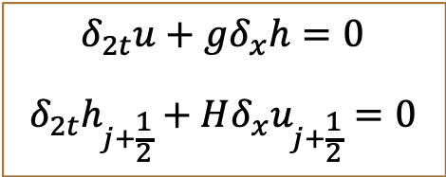
Staggered grids: shallow-water eqs
$$\frac{∂u}{∂t}+U\frac{∂u}{∂x}+g\frac{∂h}{∂x}=0$$
$$\frac{∂h}{∂t}+U\frac{∂h}{∂x}+H\frac{∂u}{∂x}=0$$
Unstaggered
Staggered
$$δ_{2t}u+gδ_{x}h=0$$
$$δ_{2t}h_{j+\frac{1}{2}}+Hδ_{x}u_{j+\frac{1}{2}}=0$$
Durran’s book
Discrete-dispersion relation:
$$sinω∆t=±\frac{2c∆t}{∆x}sin\frac{k∆x}{2}$$
$$\left|\frac{c∆t}{∆x}\right|≤\frac{1}{2}$$
Stability criterion: , more strict than unstaggered grid scheme.

Slide 14
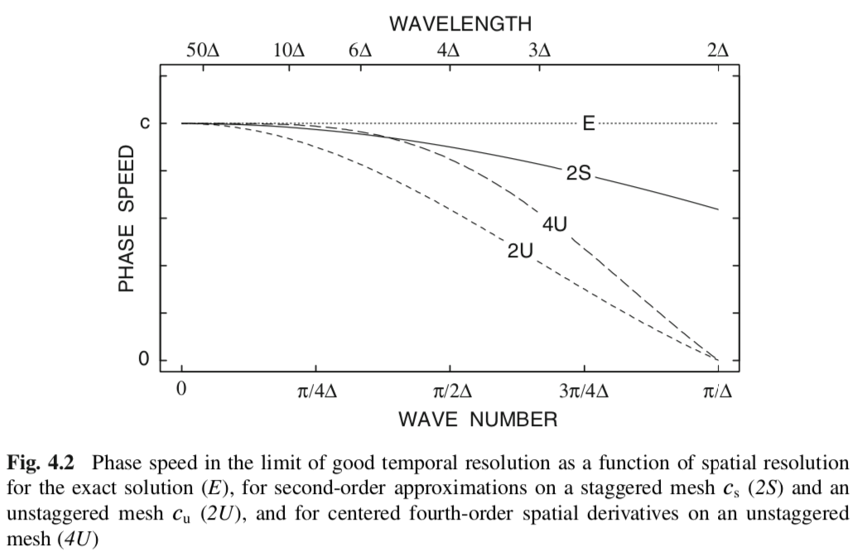
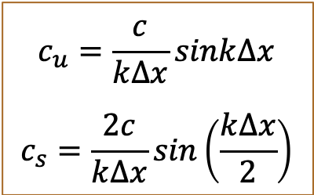
Superior Property of Staggered Grid
Durran’s book
$$c_{u}=\frac{c}{k∆x}sink∆x$$
$$c_{s}=\frac{2c}{k∆x}sin\left(\frac{k∆x}{2}\right)$$
Staggered grid: smaller differences in phases & less dispersive.
Phase
speeds:

Slide 15
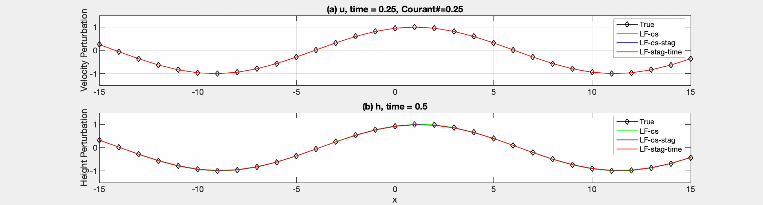
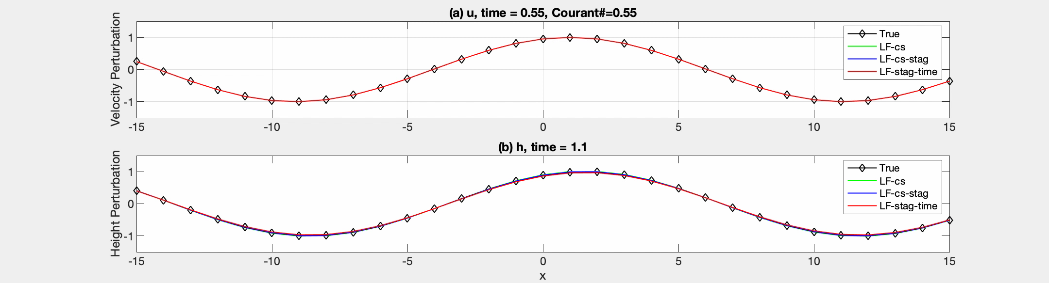
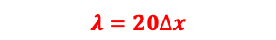
Programming & Comparison of Staggered and Unstaggered Schemes
U=0
$$λ=20∆x$$
U=0

Slide 16
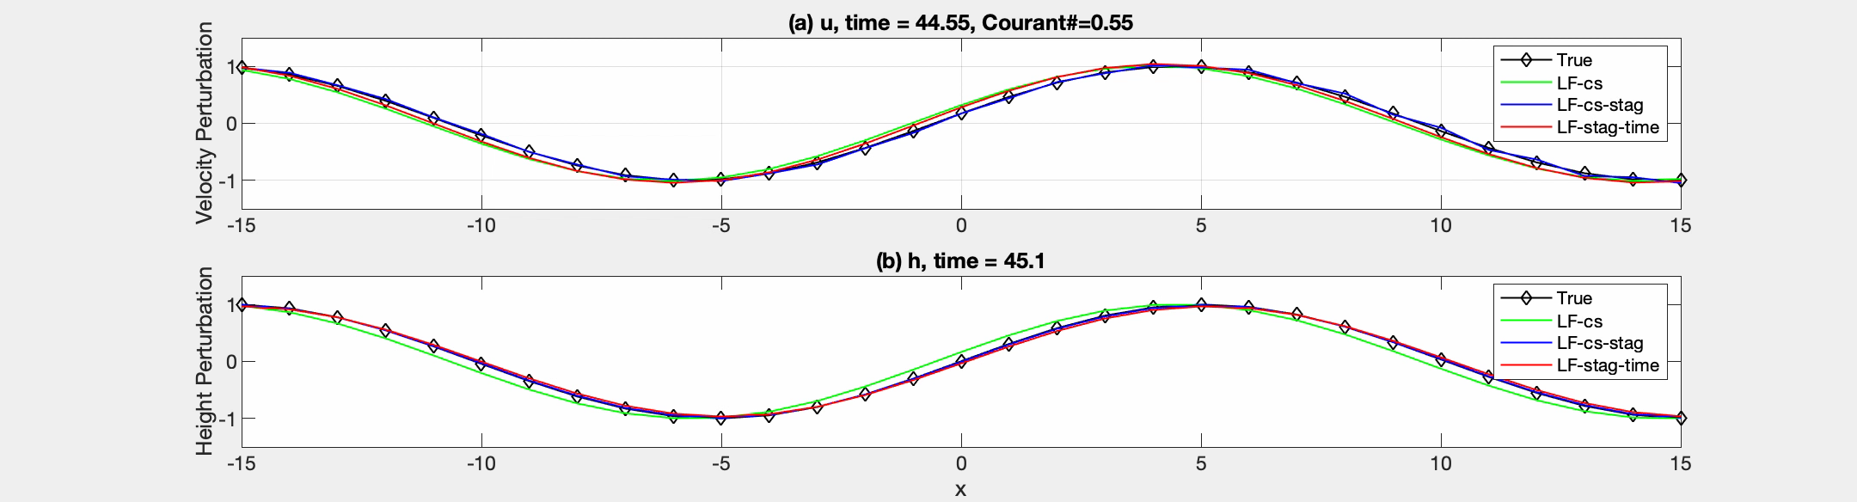
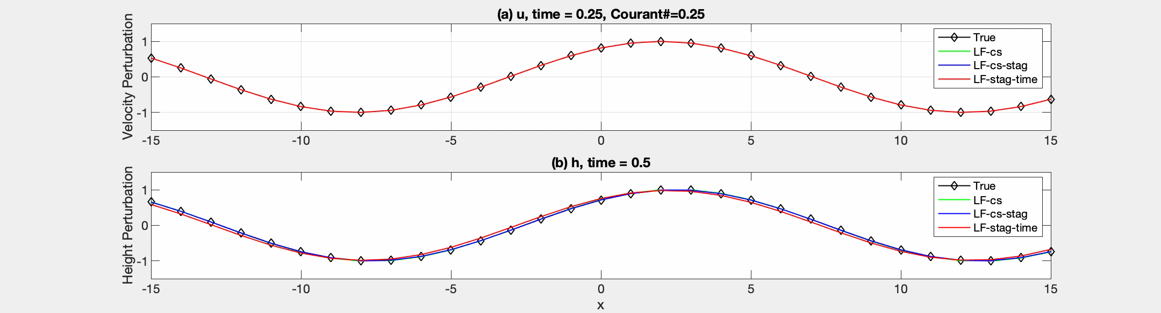

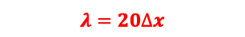
Programming & Comparison of Staggered and Unstaggered Schemes
$$λ=20∆x$$
U=0
$$λ=20∆x$$
U=1
PHYS 8750, Clemson

